Slide 2
Data Streaming and IoT
Using Pivotal Big Data Suite

Slide 3

The Journey to the Data-Driven Enterprise
Converging Trends
Internet
of Things
Big Data
Data Science &
Machine Learning
Innovation
New Data
New Processes
New Insights

Slide 4








Migrating from a reactive, static and constrained model…
Ingest
Store
Analytics
Data Lake
HDFS
Coding based
No real-time information
Based on expensive ETL
Hard to change
Labor intensive
Inefficient

Slide 5
To pro-active, self-improving, Machine Learning systems
Data Stream Pipeline
In-Memory Real-Time Data
Data Lake
HDFS
Expert System / Machine Learning
Multiple Data Sources
Real-Time Processing
Store Everything
Continuous Learning
Continuous Improvement
Continuous Adapting

Slide 6







“50-80% of the time on Data Science projects is spent on data wrangling”
Still…
New York Times Research
http://www.nytimes.com/2014/08/18/technology/for-big-data-scientists-hurdle-to-insights-is-janitor-work.html
Data Feeds
Historical Data
Stream Processing
Expert Systems Machine Learning
Data Lake
Business Value
HDFS
Smart Decisions

Slide 7



Data Stream needs an Agile, Scalable and Fast solution
Ingest
Transform
Sink
SpringXD
GemFire
Data Lake
HDFS
HAWQ

Slide 8
Spring XD orchestrates and automates all the steps on Data Stream Pipelining
Distributed Computing
Ingest
Transform
Sink
In-Memory Real-Time Data
SpringXD
Extensible
Open-Source
Fault-Tolerant
Horizontally Scalable
Data Lake
HDFS
Expert System / Machine Learning

Slide 9


Spring XD – State of the Art Data Pipeline automation
Ingest / SINK
Process
Analyze
No coding required
Dozens of built-in connectors
Seamless integration with Kafka, Sqoop
Create new connectors easily using Spring
Call Spark, Reactor or RxJava
Built-in configurable filtering, splitting and transformation
Out-of-box configurable jobs for batch processing
Import and invoke PMML jobs easily
Call Python, R, Madlib and other tools
Built-in configurable counters and gauges

Slide 10
GemFire provides scalable, low-latency data access, storage and event processing
Distributed Computing
Ingest
Transform
Sink
SpringXD
GemFire
Extensible
Open-Source
Fault-Tolerant
Horizontally Scalable
Data Lake
HDFS
Expert System / Machine Learning

Slide 11
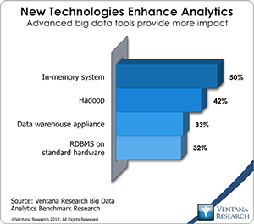
GemFire – In-memory Real Time Data
In-Memory Enterprise Data Grid
Horizontally Scalable, Consistent, Highly Available
Event handling
Continuous Queries
Enterprise Data Geo Distribution

Slide 12
HAWQ provides SQL based advanced analytics on top of Hadoop / HDFS
Distributed Computing
Ingest
Transform
Sink
SpringXD
GemFire
Extensible
Open-Source
Fault-Tolerant
Horizontally Scalable
Data Lake
HDFS
Expert System / Machine Learning
HAWQ

Slide 13
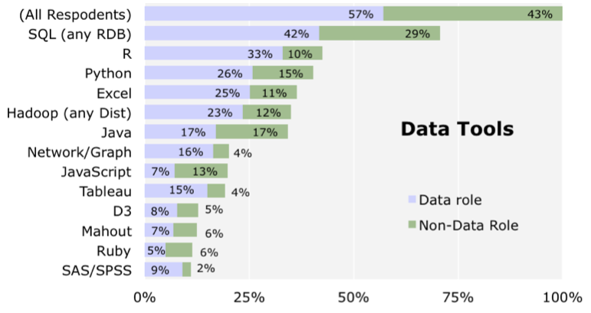
HAWQ – Advanced SQL analytics in Hadoop
Massively Parallel Processing RDBMS on HADOOP
ANSI SQL on Hadoop
Extremely high performance for analytics (not like Hive)
Stores all data directly on HDFS
Open-Source
SQL remains #1 choice for Data Science
Combining SQL with Hadoop is key for analytics

Slide 14
Developers and Data Scientists can focus on the Business Value of Data
Ingest
Transform
Sink
SpringXD
GemFire
SQL
Extensible
Open-Source
Fault-Tolerant
Horizontally Scalable
Data Lake
HDFS
SQL
HAWQ

Slide 15



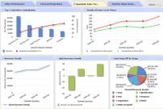





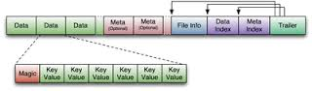
Data Streaming Reference Architecture
Data Feeds
Transactional Apps
Analytic Apps
Data Stream Pipeline
Distributed Computing
Real-Time Data
Expert Systems & Machine Learning
Advanced Analytics
Data Lake
HDFS

Slide 16

Data Streaming Reference Architecture
Data Feeds
Transactional Apps
Analytic Apps
Ingest
Filter
Enrich
Sink
SpringXD
GemFire
HAWQ
GPDB
Data Lake
HDFS

Slide 17
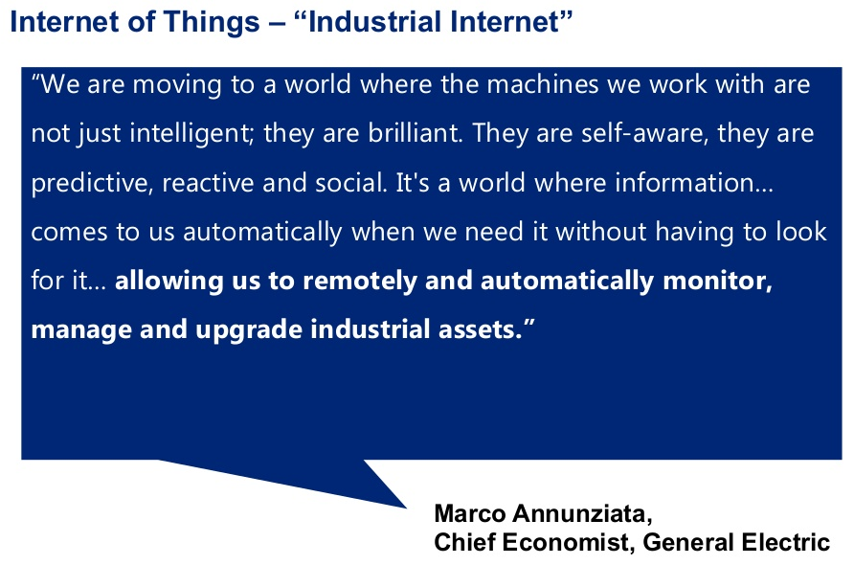
Improve Design

Slide 18
The IoT Market Verticals
Diversified Industrial Manufacturers
Agriculture, Security, Retail
Auto Manufacturers
Media (via Mobile devices)
Urban Infrastructure, Cities
Consumer, Connected Home etc.

Slide 19
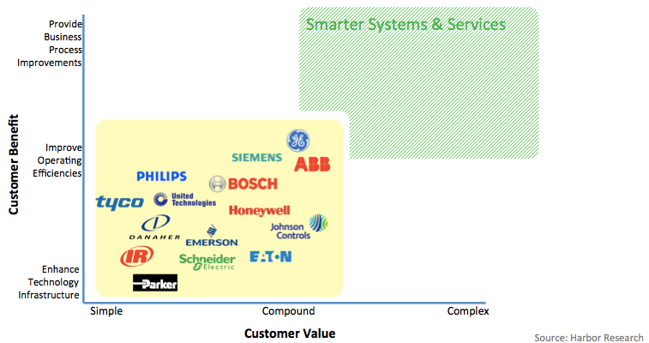
IoT Strategy as a Differentiator

Slide 20
GE Aviation – Big Data & IoT
Goal
Improve jet engine efficiency and increase service profitability
Unable to store & analyze massive amounts of data for analytics
Solution
Large data sets ingested via batch
Store 100s TB of engine data in Hadoop (PHD)
Open doors for industrial engineers to poke at data (HAWQ)
Fast Machine Learning based algorithms
2000x faster, 10x cheaper
Customer portals for visibility

Slide 21
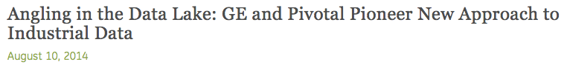

GE Aviation – Big Data & IoT
http://www.gereports.com/post/94170227900/angling-in-the-data-lake-ge-and-pivotal-pioneer
Pivotal HD
HAWQ

Slide 22
GE Energy – Fast Data & IoT
Goal
Failing gas turbines causing issues with power generation
Unable to store & process fire-hose of data
Solution
High Velocity data ingestion from Gas Turbines
Store 10 TB of turbine data in memory (GemFire)
Very Low Latency and High Speed data access
“Predictive” Maintenance

Slide 23
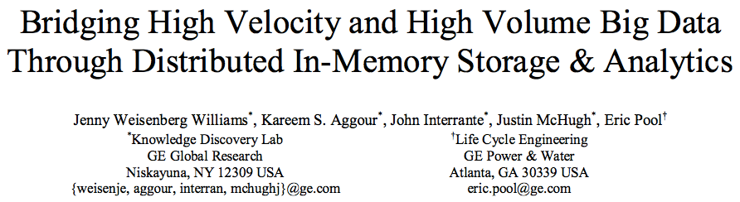
GE Energy – Fast Data & IoT
http://ieeexplore.ieee.org/xpl/articleDetails.jsp?reload=true&arnumber=7004325
GemFire

Slide 24
GE Transportation – Big & Fast Data
Goal
Help rail companies manage locomotives better
Fast data from tracks & Big data from sensors in locomotives
Solutions
Machine Learning model built from combined data set (MADLib)
Real time scoring of rail sensor data (Spring XD)
Real-time alerting of critical events via email & a real time dashboard (Spring)

Slide 25
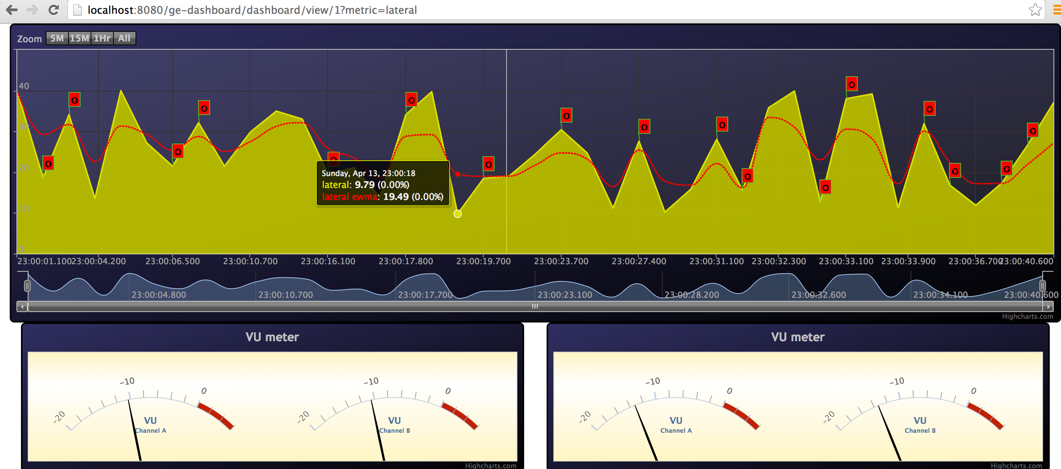
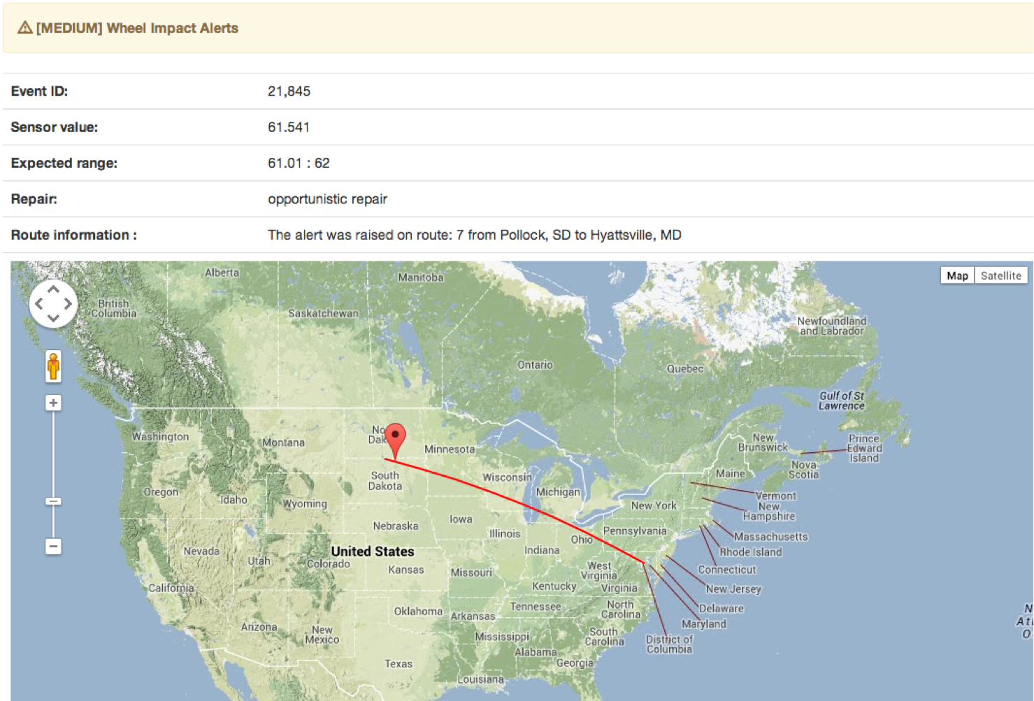
SpringXD

Slide 26
Monsanto – Agriculture & IoT
Goal
Help farmers maximize crop yields
Solution
Use of Big Data to collect & store data from farm equipment
Combine with climate and other information
Build custom apps using an agile app dev platform (PCF)

Slide 27
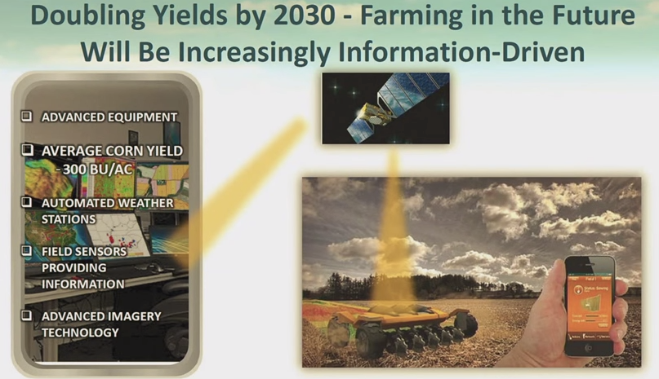
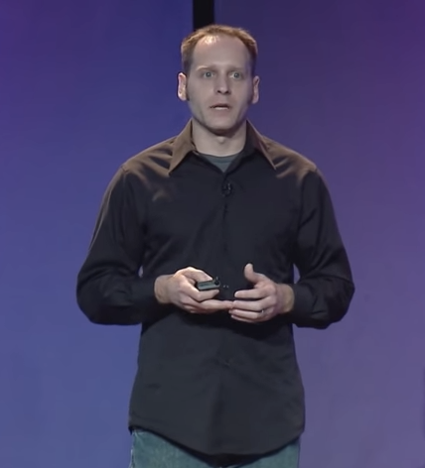


Slide 28



IoT - Need for a Platform
Pivotal Cloud Foundry
Pivotal Big Data Suite
A Better Customer Experience
Using Innovative Data-Driven Apps On a Integrated Platform

Slide 29








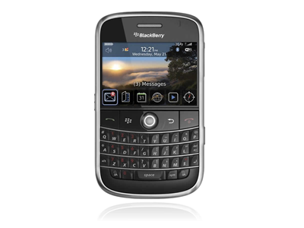




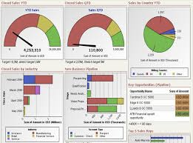
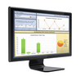
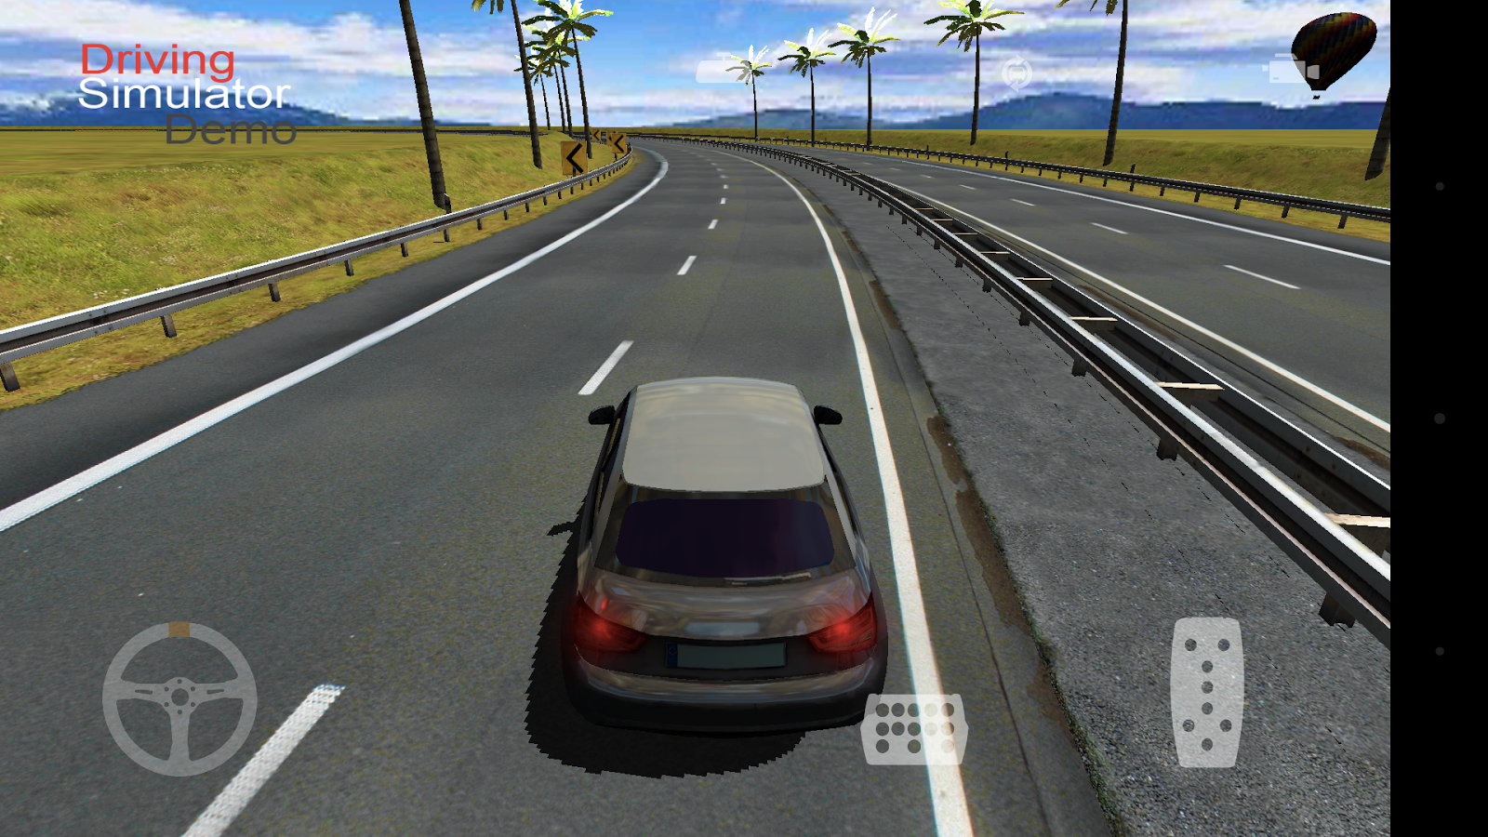
The Connected Car Architecture
Ingestion
Stream Processing
Data Lake
Enrich
Transform
Sink
JSON / HTTP
Pivotal HD
Spring XD
Mobile
Services
Real-time Data Insights
Advanced Analytics
Push
GemFire
HAWQ
Microservices
IoT Apps
Pivotal CF
Dashboard
Analytics App
Simulator

Slide 30


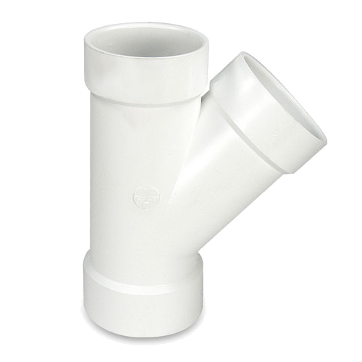



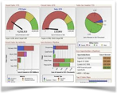

Mobile App
Stream Processing
Data Lake
+ Timestamp & GUID
+ MPG, range & route
SpringXD
Sink
JSON
Pivotal HD
Advanced Analytics
Tap
Enricher
Predictive
Analytics
HAWQ
Car Sensor
Horizontally Scalable
Fault Tolerant
Extensible
Open-Source
Real-time Data Insights
GemFire
Dashboard

Slide 31
